Slide 1
Update Xenxible Project Device Identifier
Syaziyah

Slide 2
MACHINE LEARNING PIPELINE
INPUT
(Customer, Project, Device ID)
UPDATE ON (16.04.2026)
1
ML MODEL
RETRIVE
[new_equipment.pkl]
XGBoost
NEW LIST OF EQUIPMENT
3
Cluster
Section
UNKNOWN
= Assign by User
RESULT OUTPUT
(Customer, Project, Device ID, Section, Cluster)
2
Process flow
(1) Input - Model – Result Output – Update & Save Model
(2) Input - Model - Output (UNKNOWN) - Assign by user – New Equipment Data
- Model – Update & Save Model
(3) New Equipment Data - Model - Update & Save Model
UPDATE & SAVE MODEL

Slide 3
MACHINE LEARNING PIPELINE
INPUT
(Customer, Project, Device ID)
CREATE ON (18.03.2026)
UPDATE ON (20.0.2026)
NEW LIST EQUIPMENT
ML MODEL
UPDATE & SAVE MODEL
PREFIX
SUFFIX
SGD Classifier Hybrid Model
- SGD Classifier
- Composite Similarity
XGBoost
XGBoost
Device Type
Section
Cluster
UNKNOWN
= Assign by User
RESULT OUTPUT
(Customer, Project, Device ID, Device Type, Section)
UPDATE & SAVE MODEL

Slide 4
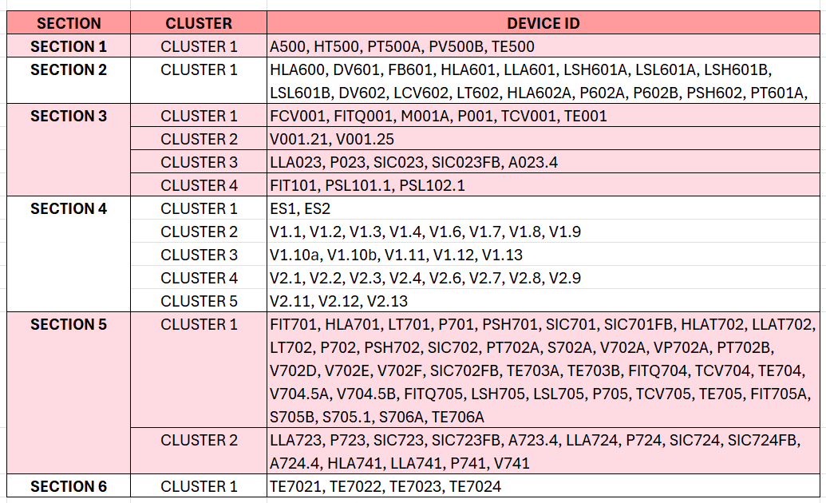
OILTEK – USING IN TRAINING
PROJECT : A1706
CUSTOMER : OILTEK
TOTAL DEVICE : 130
Filepath : "C:\Users\sitisyaziyah\Documents\Device_Identifier\Dummy data\Oiltek - structured data.xlsx“

Slide 5
UPDATE 31/07/2026

Slide 6
UPDATE
DATE | Progress | Details | Status
31/07/26 | 1. Draft flowchart | Stage 1- Stage 3 | Pending on Stanley review
31/07/26 | 2. Using Dummy data for logic | Refer to the slide “Movement of dataset [UDPATE 04/08/26]” | Completed ✅
31/07/26 | 3. Cleaning README.md | Synch with devops | Completed ✅

Slide 7
UPDATE 04/08/26
DATE | Progress | Details | Status
04/08/26 | Update full flowchart ML Source : flowchart ML developmemt.xlsx | Model development Model application Result of model evaluation | On drafting – preparation for training
04/08/26 | 2. Draft flowchart | Stage 1- Stage 3 | Pending on Stanley review
04/08/26 | Source dataset for TRAINING MODEL SGD Classifier : C:\Users\sitisyaziyah\Documents\Device_Identifier_MainFolder\Dataset\output\masterfile.csv XGBoost C:\Users\sitisyaziyah\source\repos\DeviceCluster\1.training_model\dummy_data | SGD Classifier : Wilmar, Oiltek, UGS XG Boost: Wilmar, Oiltek, UGS (edit!!) | Completed ✅
04/08/26 | 3. Logic dll development in visual studio |  | In progressing (start : 5/8/2026)

Slide 8
UPDATE 05/08/26
DATE | Progress | Details | Status
05/08/26 | Decision of 2 methode in cluster logic : Max (highest predicted cluster) choose it independently Constraint based similarity (consider the percentage first then select the most fit one) |  | In planning Not execute in coding
05/08/26 | Logic dll development in visual studio |  | In progressing (start : 5/8/2026)

Slide 9
UPDATE 17/08/26
DATE | Progress | Details | Status
17/08/26 | Build up new pipeline EQUIPMENT TYPE = Logic function – no model involve | Script “predict_equipment.py” Integrated inside C# | Complete in pipeline C#
 | Section and Cluster = XGBoost Model | Proceed as previous model
18/08/26 | Handle JSON file in c# A9998_devices.json = Name based on the project from SQL unallocated_device_ids.json = Single file, Dedupe key and unique (DeviceId + ProjectCode), Status lifecycle floating_deviceid.json = Used in quota allocation, contain percentage prediction of cluster, Single file |  | Complete in pipeline C#
18/08/26 | Handle JSON file in c# A9998_devices.json = model.dll unallocated_device_ids.json = logic.dll floating_deviceid.json = logic.dll |  | Complete in pipeline C#

Slide 10
UPDATE 19/08/26
DATE | Progress | Details | Status
19/08/26 | Change dbo.DummySection2OiltekA9998 into dbo.DummyTestingData (1 project) | Complete change for all related path | Synch in Git
19/08/26 | Add class function in PythonSQL [LoadProjectDataAsync] |  | Synch in Git
19/08/26 | Add multiple project with many client |  | Synch in Git
19/08/26 | Check json make sure unique for 1 entry unallocated_device_ids.json floating_deviceid.json |  | Synch in Git
19/08/26 | Pattern hardcoded in assign cluster – GetDraftQuotas() PROBLEM : current example only applicable for SCETION 2 only. ACTION : need to create dummy pattern for cluster quota allocation for ALL the section = by CustomerCode TYPE FILE : SQL [dbo.PatternCluster] |  | Synch in Git

Slide 11
UPDATE 20/08/26
DATE | Progress | Details | Status
21/08/26 | Setup the output console aps for fulfilled and vacant |  | Synch in Git
21/08/26 | Sync mindmap and coding |  | Synch in Git
21/08/26 | Add dbo.DeviceReviewQueue |  | Synch in Git
21/08/26 | Setup output dbo in SQL – dbo.OutputDeviceAssignment |  | Synch in Git
21/08/26 | Insert Output db SQL return back |  | Synch in Git
26/08/26 | Question : Should I save in json or SQL If inside JSON, how the UI can detect and relate Suggestion = save in SQL so that easier to map |  | Synch in Git
PENDING | Using Nuget to andover the dll library |  | PENDING
27/08/26 | Draft system architecture of ML |  | Synch in Git
28/08/26 | Create flowchart.md |  | Synch in Git

Slide 12
UPDATE 01/09/26
DATE | Progress | Details | Status
01/09/26 | Run thru the PC server port 8000 CMD files 1 click "C:\Users\sitisyaziyah\source\repos\DeviceCluster\Prediction_service\DeviceClusterServiceApp\run-service-app.cmd“ exe files : "C:\Users\sitisyaziyah\source\repos\DeviceCluster\Prediction_service\DeviceClusterServiceApp\bin\Debug\net10.0-windows\win-x64\DeviceClusterServiceApp.exe" |  | Synch in Git
01/09/26 | Server : 128.100.8.213 Port : 80 [Azure Devops] Port : 8000 [ML_SERVICE_URL] Service : http://128.100.8.213:8000 Python 3.13 ML package - scikit-learn, xgboost, pandas, numpy, scipy, joblib, fastapi, uvicorn |  | Synch in Git
01/09/26 | Finalize DeviceIdentiferProgress.pptx Filepath : "C:\Users\sitisyaziyah\source\repos\DeviceCluster\handoff\DeviceIdentifierProgress.pptx" |  | Synch in Git
01/09/26 | Register the ML service as a Windows service (via NSSM) Register the ML service as a Windows service using NSSMCurrently started by hand in a PowerShell window on SSSBPD01 — it stops when that window closes, when the user logs off, or when the server reboots NSSM wraps python -m uvicorn service:app --host 0.0.0.0 --port 8000 so Windows starts it automatically at boot and restarts it if it fails |  | Synch in Git

Slide 13
UPDATE 02/09/26
DATE | Progress | Details | Status
02/09/26 | Revise documentation handoff\DeviceIdentifier-API-FullReference.docx handoff\DeviceIdentifier-API-QuickReference.docx |  | Synch in Git
02/09/26 | Revise slide presentation PPTX handoff\DeviceCluster-Briefing.pptx handoff\DeviceIdentifierProgress.pptx |  | Synch in Git
02/09/26 | Entry point DevicePipeline.RunAsync in Logic.dll |  | Synch in Git
02/09/26 | End point DevicePipelineResult with the assigned, unknown and unallocated devices, and writes the same results to dbo.OutputDeviceAssignment and dbo.DeviceReviewQueue. |  | Synch in Git
10/09/26 | Change the update in Excel. Continue updating info inside excel

Slide 14
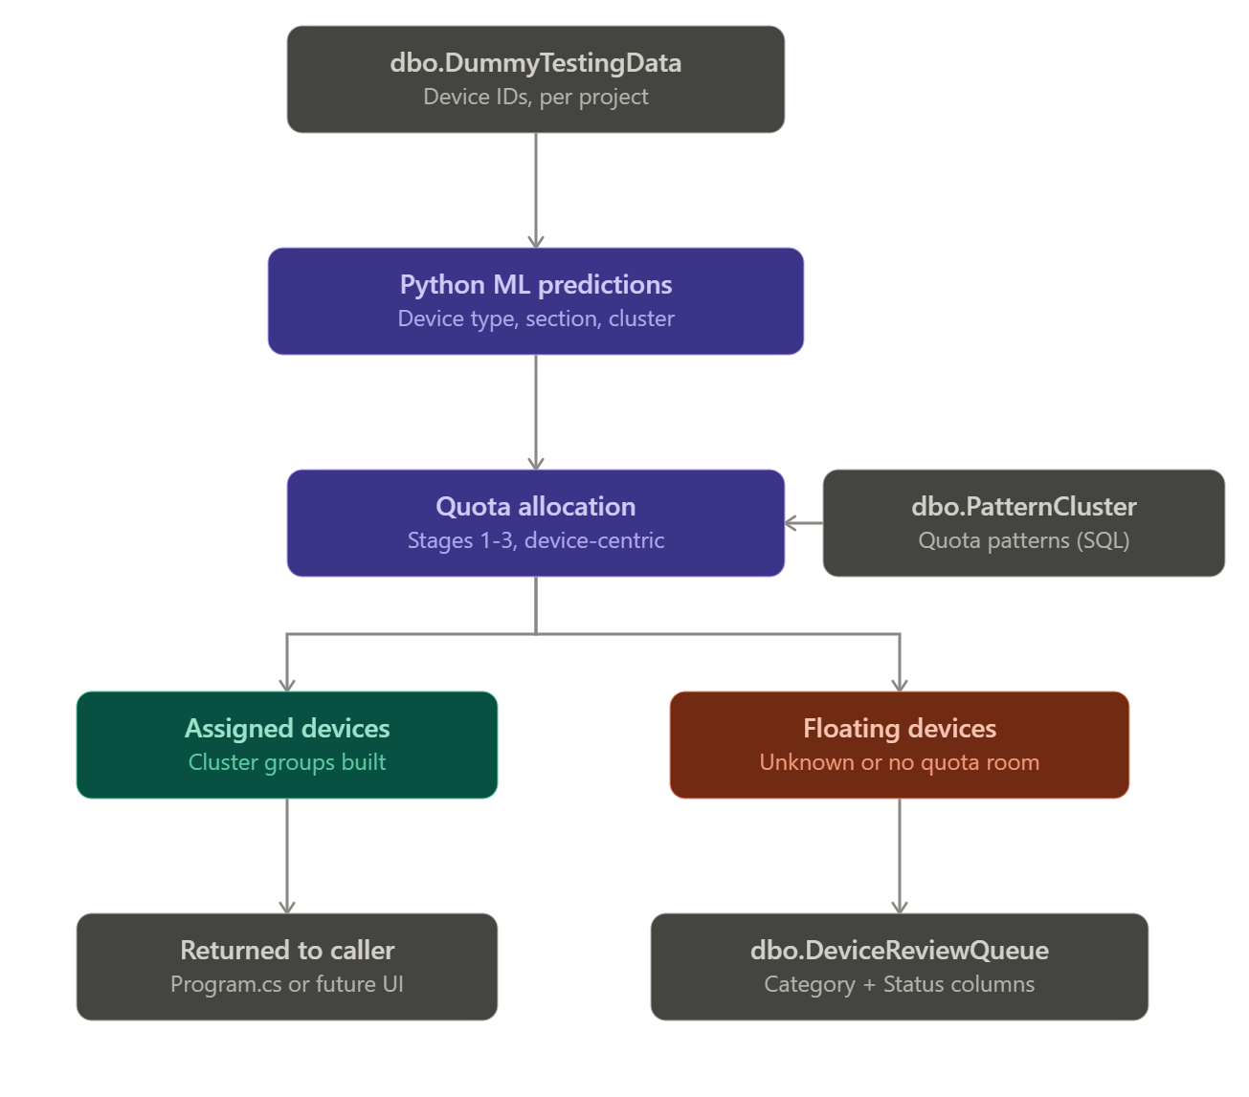

Slide 15
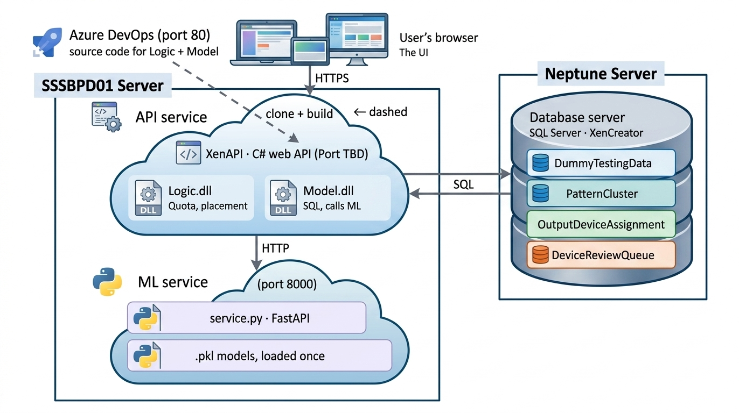

Slide 16
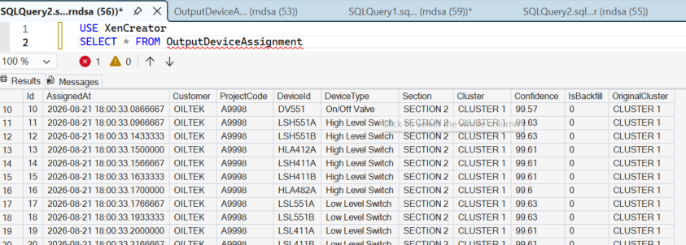
Result – dbo.OutputDeviceAssignment

Slide 17
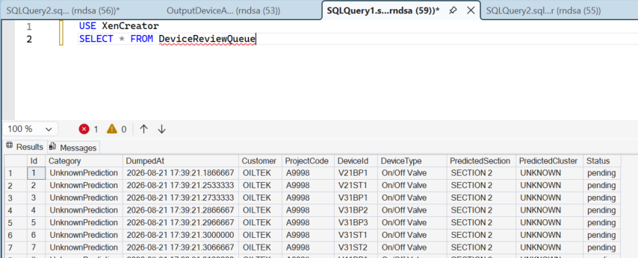
Result – dbo.DeviceReviewQueue

Slide 18
JSON file
** has been removed from the script since and change into SQL dbo table
 | unallocated_device_ids.json | floating_deviceid.json
Trigger condition | Known prediction (DeviceType/Section/Cluster all valid) but no quota bucket had room | Any of DeviceType/Section/Cluster is UNKNOWN
Timing | After quota allocation (from AllocationResult.Floating) | After quota allocation (from AllocationResult.Floating) — same moment as left, not a different stage
Percentage / confidence | Not stored — entry has no Score/Confidence field | Not stored — same, no Score/Confidence field either
File scope | Single file, shared across all projects | Single file, shared across all projects
Dedupe key | DeviceId + ProjectCode | DeviceId + ProjectCode
Status lifecycle | "pending" → "assigned" (via MarkAsAssigned, once a human manually places it) | "pending" only — nothing in the code ever updates it
Assembly | Logic.dll | Logic.dll
Write method | LogicAssignment.DumpUnallocated | LogicAssignment.DumpFloating

Slide 19
How the cluster_floating_device_ids.json obtain?
2. The quota allocator already tried — it doesn't retry from the file
The allocator isn't a queue that keeps attempting to place floating devices later. It runs its own internal two-pass process before anything is written to floating_deviceid.json:
Step 1 (lines 116-162): direct match on Section + Cluster + DeviceType, top-N by score.
Step 2 (lines 164-170): whatever's left becomes the internal "floating pool" for that section.
Step 3 (lines 172-214): backfill — pulls from that same floating pool to fill remaining deficits, matched loosely by Section + DeviceType (ignoring the originally predicted cluster).

Slide 20
floating_deviceid.json ← devices where DeviceType == "UNKNOWN" or Section == "UNKNOWN" or Cluster == "UNKNOWN“
unallocated_device_ids.json ← devices where all three are valid/known, but still didn't get claimed by any quota bucket (capacity full, or no bucket exists for that combo)

Slide 21
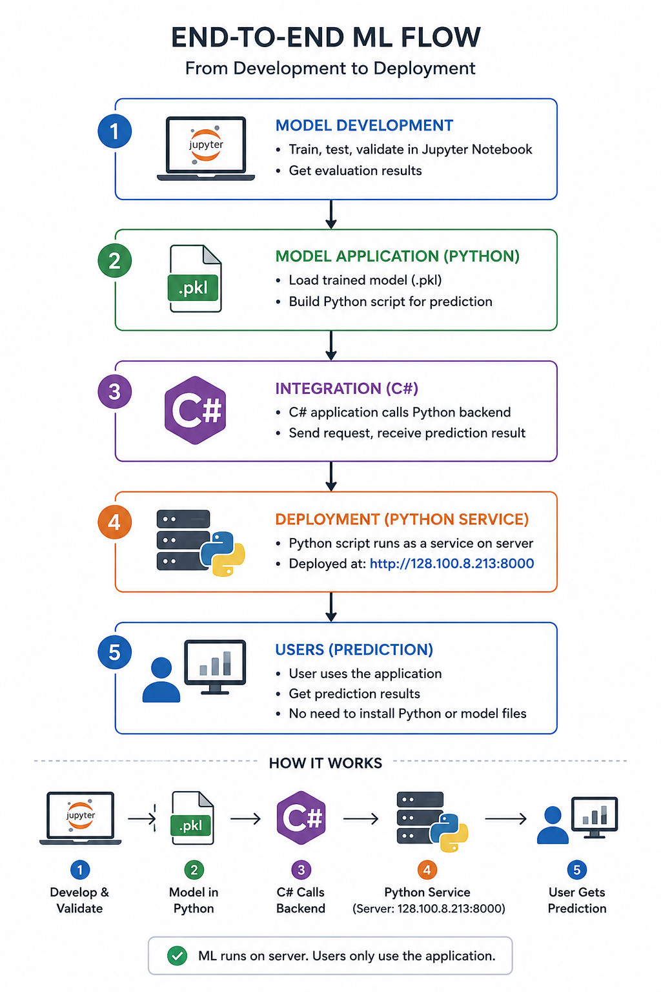

Slide 22
Movement of dataset [UDPATE 04/08/26]
SGD Classifier
Received 8 RAW excel files in zip files [Dataset/1. raw_data]
Used for training SGD model
Clean each excel file
[Dataset/2. clean_data]
Merge into 1 csv files
[Dataset\output\masterfile.csv]
master_df.pkl
XGBoost
Dummy data
[repos\DeviceCluster\1.training_model\dummy_data]
UGS (A1706-A1995)
Oiltek (A2027-A8885)
Used for training XGB model

Slide 23
Full Flowchart DLL Library Model (18/082026)
SQL Database
{ProjectCode, CustomerCode, DataIds}
JSON File
[Dataset/2. clean_data]
TRAINING DATASET
OILTEK
A1706 (REFERENCE)
A9991, A9992, A9993, A9994, A9995
[Source SQL db = A9998]
UGS
A2027 (REFERENCE)
A8881, A8882. A8883, A8884, A8885

Slide 24
Full flowchart
1. Flowchart ML development.xlsx

Slide 25
clu_proba_raw = model_cluster.predict_proba(X_clu) # ← full probability array, one score per cluster class
clu_pred_enc = np.argmax(clu_proba_raw, axis=1) # ← THIS is where it picks the max
clu_conf_raw = clu_proba_raw.max(axis=1) # ← and this grabs the max value itself

Slide 27
UDPATE 10/07/2026

Slide 28
To do list 20/07/2026
Confirmation training with HR
Extract the pattern dataset of Section 2 Cluster OILTEK
Transform into tabulation dataset
Ask claude to find which line of python script predict_sectioncluster.py that showing all the percentage prediction for each cluster before showing/pickup the highest percentage
Find the line in python script of the predict_sectioncuster.py that give percentage of all the possibilities in the cluster.
Setup in descending order
List out all the possibilities of dataset that might bring confusing

Slide 29
TAKE NOTE THIS SCRIPT
Script that pikup the max prediction percentage
ratio = np.maximum(0, avg_dist - ood_threshold) / ood_threshold
adjusted = conf_raw / (1 + ratio)
Or this script:
# ── Section prediction (single best, same as predict()) ────────────
X_sec = df_feat[section_features].apply(pd.to_numeric, errors="coerce").fillna(0)
sec_proba_raw = model_section.predict_proba(X_sec)
sec_pred_enc = np.argmax(sec_proba_raw, axis=1)

Slide 30
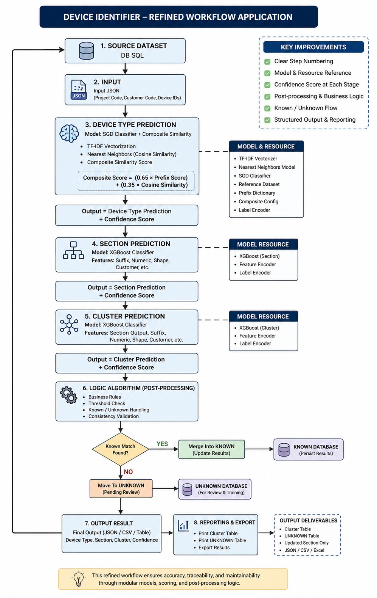

Slide 31
Full flowchart

Slide 32
PREDICTION MODEL
UNKNOWN
KNOWN SECTION & CLUSTER
CLUSTER
Equipment Type, Section
= Assign by the User
Cluster
= Logic (within same section)
FULL
VACANT

Slide 33
PREDICTION MODEL
Approach 1
UNKNOWN
KNOWN SECTION & CLUSTER
CLUSTER
Equipment Type, Section
= Assign by the User
Cluster
= Logic (within same section)
FULL
VACANT

Slide 34
PREDICTION MODEL
Approach 2
UNKNOWN
KNOWN SECTION & CLUSTER
CLUSTER
Equipment Type, Section
= Assign by the User
Cluster
= Logic (within same section)
FULL
VACANT

Slide 35
Approach 2
PREDICTION
LOGIC
STAGE 1
Highest Percentage fill up the Cluster
CLUSTER = FULL
CLUSTER = VACANT
STAGE 3
Conflict Case
STAGE 2
Kick and replace mechanism
STAGE 4
Solve Conflict Case

Slide 36
Approach 1

Slide 37
PREDICTION MODEL
Approach 1
UNKNOWN
KNOWN SECTION & CLUSTER
CLUSTER
Equipment Type, Section
= Assign by the User
Cluster
= Logic (within same section)
FULL
VACANT

Slide 38
Approach 10/07/2026:
Run prediction model
Logic sort the model into section and cluster based on the prediction result
Left the UNKNOWN cluster
UNKNOWN cluster
-Check the top 3 highest percentage
-Load the top 3 cluster obtain from the highest percentage
-Match the pattern algorithm
-Is the equipment exist in the cluster algorithm reference? Yes/No
-NO = EXCLUDE THE CLUSTER
-YES = Proceed with the selection.
-If there is more than 1 similar device type across cluster, which cluster should choose? = choose the cluster in which no Device Type inside.

Slide 39
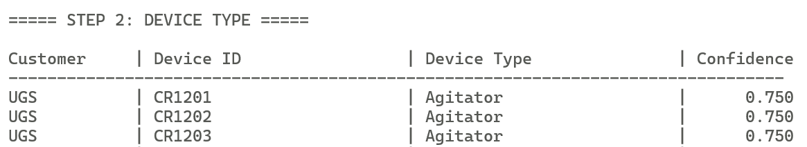
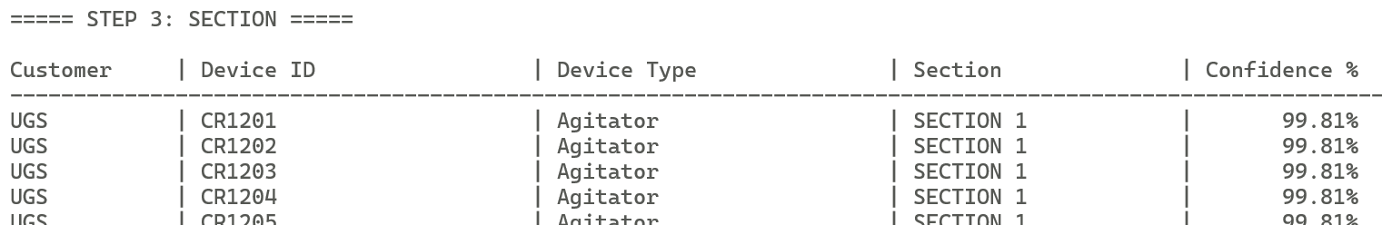
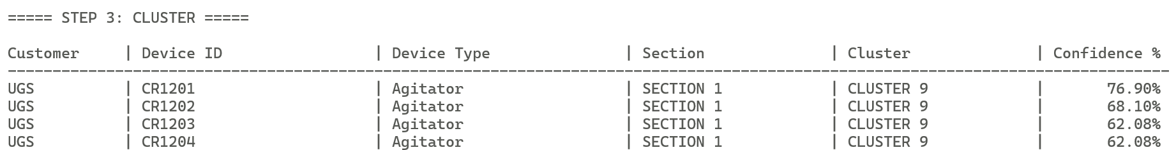
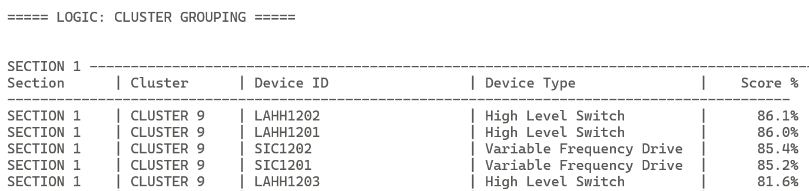
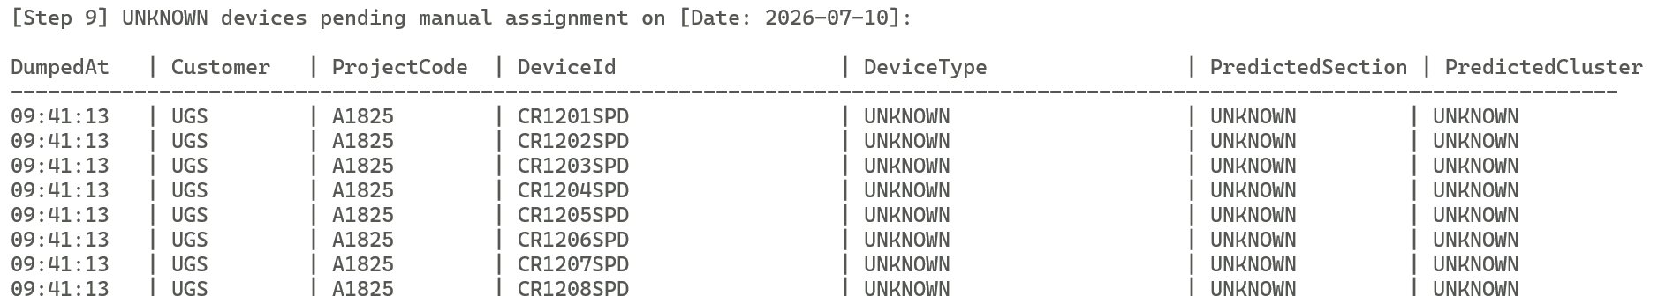
DEVICE TYPE
DEVICE SECTION
DEVICE CLUSTER
SECTION CLUSTER
GROUPING
UNKNOWN

Slide 40
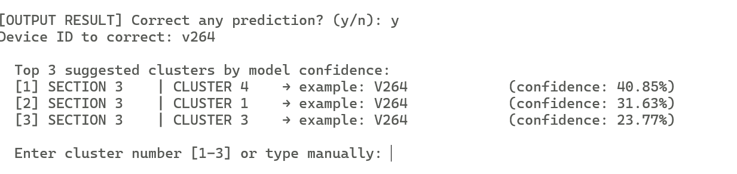
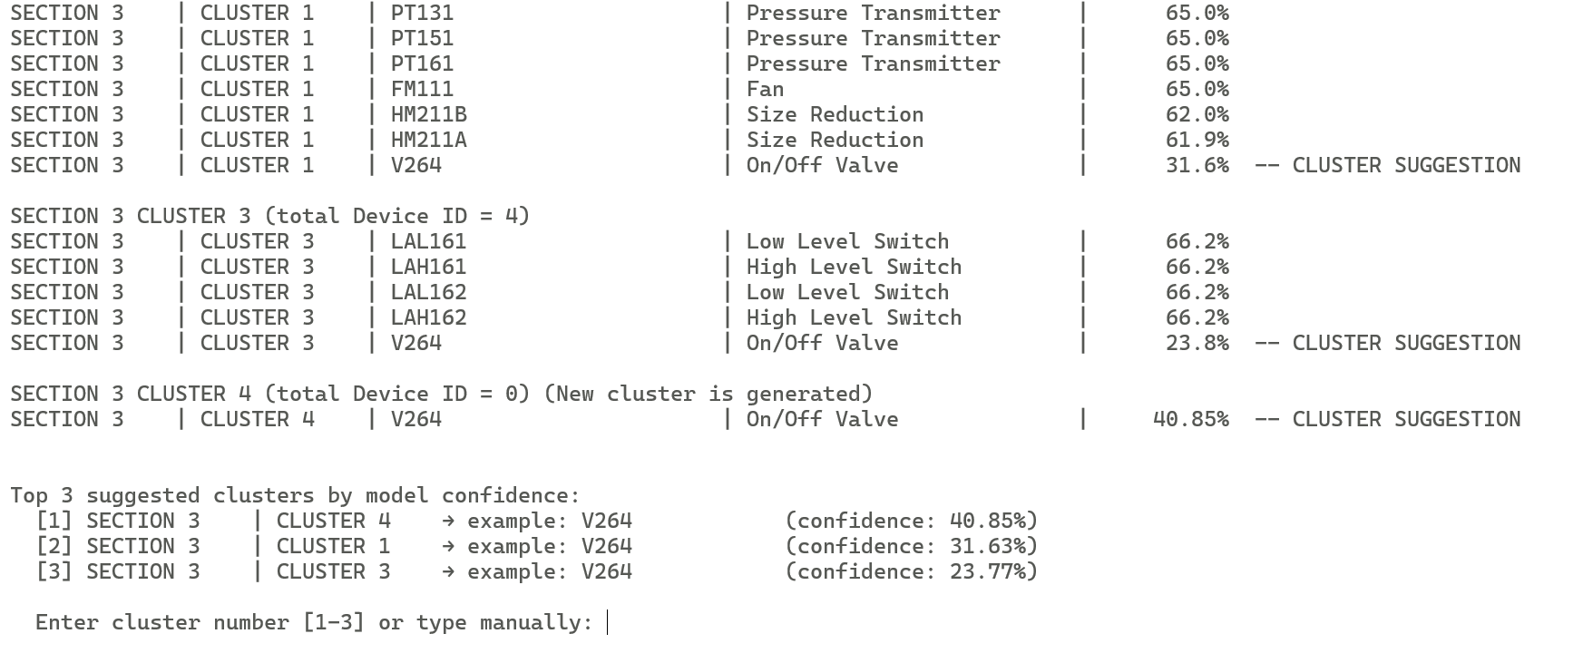
UNKNOWN
ENTER THE DEVICE ID
with UNKNOWN CLUSTER
LOGIC suggest
the CLUSTER location

Slide 41
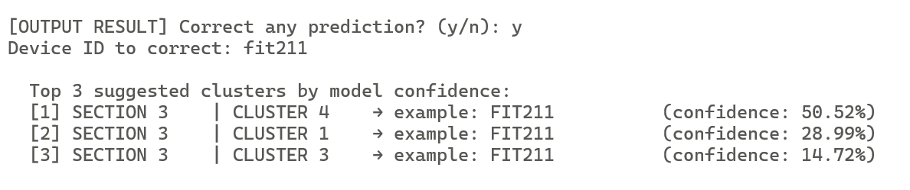
GENERATED ON 14/07/2026
EXAMPLE
FIT211 – SECTION3 CLUSTER UNKNOWN

Slide 42
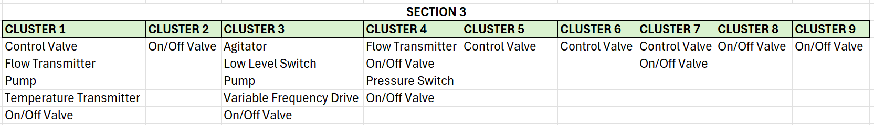
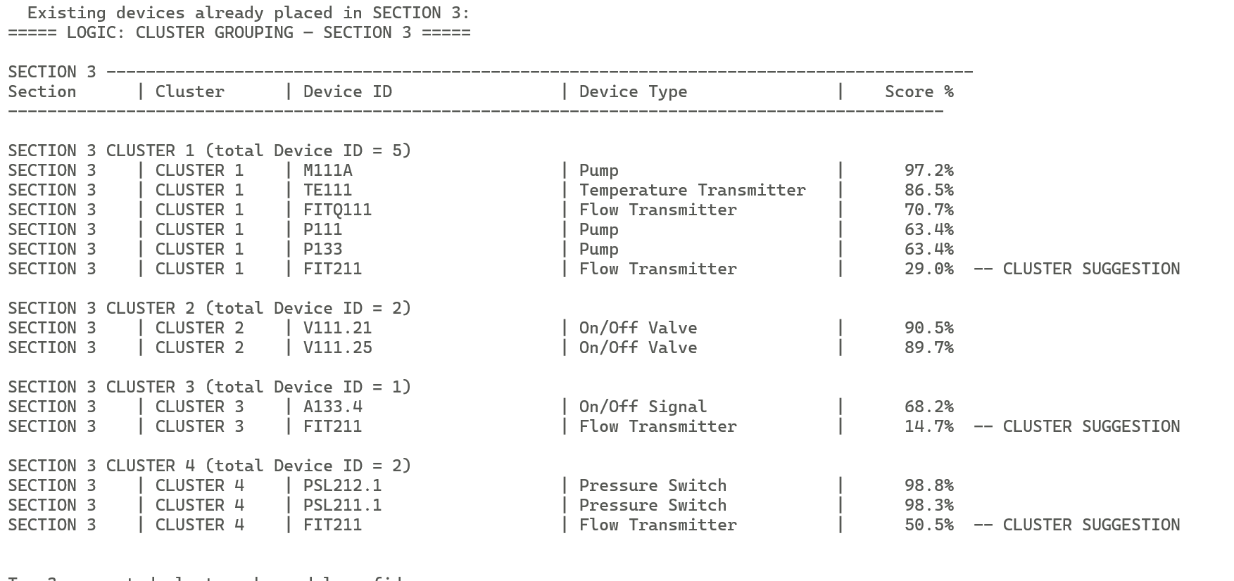
GENERATED ON 14/07/2026
FIT211 – SECTION3 CLUSTER?

Slide 43
Approach 2

Slide 44
LOGIC ALGORITHM
[16/7/2026]

Slide 45
PREDICTION MODEL
Approach 2
UNKNOWN
KNOWN SECTION & CLUSTER
CLUSTER
Equipment Type, Section
= Assign by the User
Cluster
= Logic (within same section)
FULL
VACANT

Slide 46
PREDICTION
LOGIC
STAGE 1
Highest Percentage fill up the Cluster
CLUSTER = FULL
CLUSTER = VACANT
STAGE 3
Conflict Case
STAGE 2
Kick and replace mechanism
STAGE 4
Solve Conflict Case

Slide 47
Current Approach :
Choose 1 customer = OILTEK
Choose 1 section from OILTEK = SECTION 2
Extract the pattern for all cluster at section 2
Create the specific value device cluster for section 2 (N=100)
Introduce the pattern specific cluster into LOGIC
Run the list of Device ID from the model prediction
Logic assign the device id based on the Pattern LOGIC
Detect the cluster = Full or Vacant
Kick and replace Device ID

Slide 48
Section 2 OILTEK (REFERENCE, N=100)
CLUSTER 1
CLUSTER 2
CLUSTER 3
CLUSTER 4
Fan | 4
On/Off Valve | 6
High Level Switch | 6
Low Level Switch | 4
Control Valve | 4
Level Transmitter | 2
Pump | 5
Pressure Switch | 3
Pressure Transmitter | 2
Vibrator | 4
TOTAL | 40
On/Off Valve | 5
Control Valve | 5
TOTAL | 10
On/Off Valve | 4
TOTAL | 4
On/Off Valve | 6
TOTAL | 6
CLUSTER 5
CLUSTER 6
CLUSTER 7
CLUSTER 8
Pump | 4
Heater | 2
Temperature Transmitter | 3
Low Level Switch | 4
TOTAL | 13
Control Valve | 7
On/Off Valve | 7
TOTAL | 14
On/Off Valve | 6
TOTAL | 6
Control Valve | 7
TOTAL | 7

Slide 49
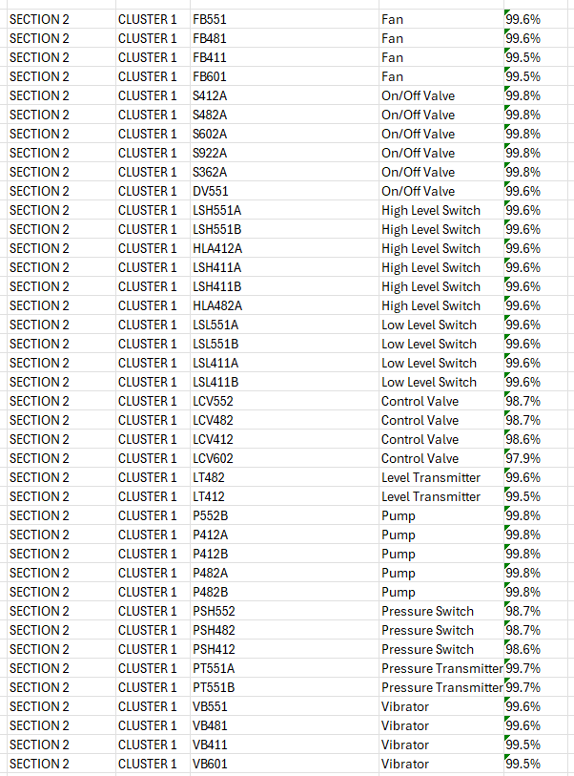
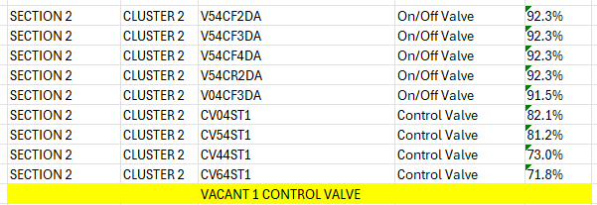

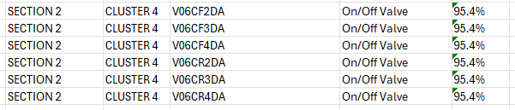
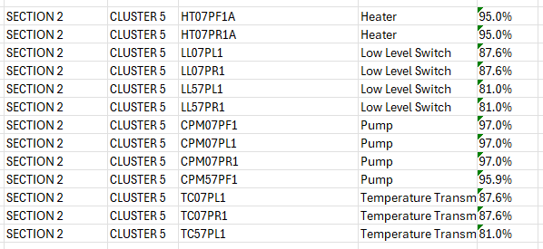
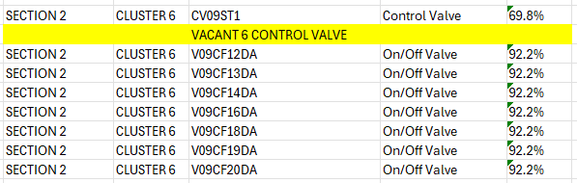
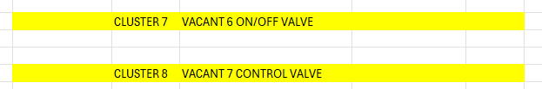
Section 2 OILTEK – EXAMPLE CASE
CLUSTER 1
CLUSTER 2
CLUSTER 3
CLUSTER 4
TOTAL | 9/10
VACANT | 1
TOTAL | 40/40
TOTAL | 4/4
TOTAL | 6/6
CLUSTER 5
CLUSTER 6
CLUSTER 7
CLUSTER 8
TOTAL | 8/14
VACANT | 6
TOTAL | 0/6
VACANT | 6
TOTAL | 0/7
VACANT | 7
TOTAL | 13/13

Slide 50
STAGE 1
Highest Percentage fill up the Cluster
FULL
VACANT (Cluster)
New Device ID coming
= compare the percentage
= kick and replace
= the highest percentage win.
So the loser will go?
Floating device ID fill up the vacant
= pick the highest percentage on the respective reference
What if still vacant?
CLUSTER 1
CLUSTER 1
CLUSTER 5
CLUSTER 7
Control Valve | 4
Fan | 4
High Level Switch | 6
Level Transmitter | 2
Low Level Switch | 4
On/Off Valve | 6
Pressure Switch | 3
Pressure Transmitter | 2
Pump | 5
Vibrator | 4
TOTAL | 40
Control Valve | 4
Fan | 4
High Level Switch | 6
Level Transmitter | 2
Low Level Switch | 4
On/Off Valve | 6
Pressure Switch | 3
Pressure Transmitter | 2
Pump | 5
Vibrator | 4
TOTAL | 40
Heater | 2
Low Level Switch | 4
Pump | 4
Temperature Transmitter | 3
TOTAL | 13
TOTAL | 0/6
VACANT | 6
All the percentage inside
the cluster is 80-90%
***both cluster is FULL
All the percentage inside the cluster is 91-99 %
All the percentage inside the cluster is 91-99 %

Slide 51
FULL CLUSTER
VACANT CLUSTER
CLUSTER 1
CLUSTER 5
CLUSTER 1
CLUSTER 7
Low Level Switch | 4
LSL411A | 99.6%
LSL551B | 97.6%
LSL411A | 93.6%
LSL411B | 90.6%
Low Level Switch | 4
LL07PL1 | 87.6%
LL07PR1 | 87.6%
LL57PL1 | 81.0%
LL57PR1 | 81.0%
On/Off Valve | 6
S412A | 99.8%
S482A | 97.8%
S602A | 94.8%
S922A | 92.8%
S362A | 91.8%
TOTAL | 0/6
VACANT | 6
All the percentage inside the cluster is 91-99 %
All the percentage inside the cluster is 80-90%
***both cluster is FULL
Case when New Device ID :
V71ST2 = On/Off Valve (93%) = Cluster?
Case when New Device ID :
LLA561 = Low level switch (93%) = Cluster?
LLA561 = Low level switch (86%) = Cluster?
LLA561 = Low level switch (72%) = Cluster?
Suggestion answer
The kick out device id is located at?
CLUSTER 1
CLUSTER 7
On/Off Valve | 6
S412A | 99.8%
S482A | 97.8%
S602A | 94.8%
V71ST2 | 93%
S922A | 92.8%
S362A | 91.8%
TOTAL | 1/6
VACANT | 5

Slide 52
THE END

Slide 53
Update script 17/07/2026
Program.cs workflow :
Console output is not as per requested. Need to restructure the way. = PROBLEM SOLVED ✅
PROBLEM AND STOP AND APPROACH 2
So: capture the data → ClusterQuotaAllocator.cs. Display the data → Program.cs. If you already replaced your Logic project's ClusterQuotaAllocator.cs with the full file I gave you last message, that half is done — you just need to update the Program.cs printing block now.

Slide 54
OBSOLETE

Slide 55
REFERENCE
[10/07/2026]

Slide 56
Case when :
Check the top 3 highest percentage
Load the top 3 cluster obtain from the highest percentage
Match the pattern algorithm.
Is the equipment existed in the cluster algorithm reference? Yes/No
NO = EXCLUDE THE CLUSTER
YES = Proceed with the selection.
If there is more than 1 similar device type across cluster, which cluster should choose? = choose the cluster in which no Device Type inside.
QUESTION! WHEN THE KICK AND REPLACE WILL WORK?

Slide 57
GENERATED ON 14/07/2026
TRAINING DATASET
OILTEK
A1706 (REFERENCE)
A9991, A9992, A9993, A9994, A9995
UGS
A2027 (REFERENCE)
A8881, A8882. A8883, A8884, A8885
MODEL APPLICATION BY Program.cs
OILTEK
A1706
OUTPUT :
TOTAL DEVICE ID = 128 ID
KNOWN = 117 ID
UNKNOWN = 11 ID

Slide 58
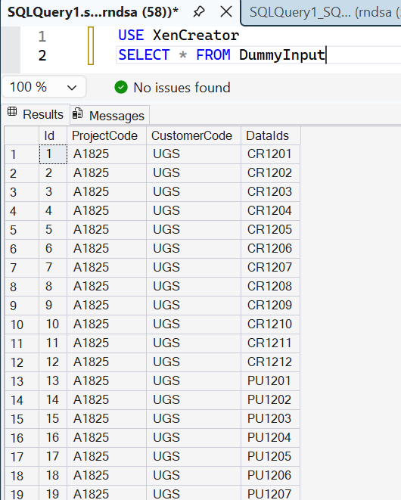
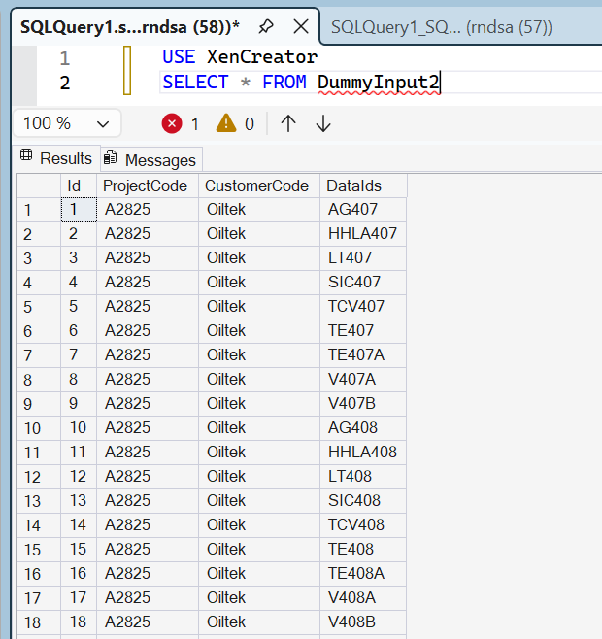

Slide 59
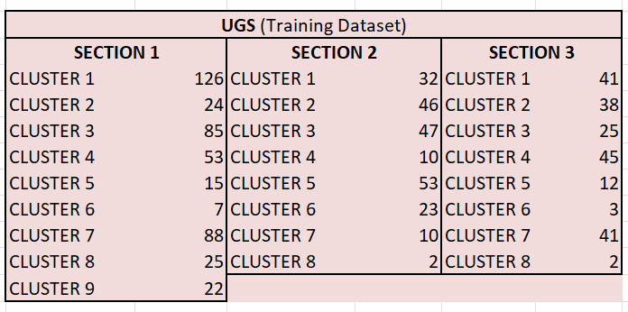
UNKNOWN CLUSTER = TOP 3 SUGGESTION
Restructure and Kick
PROBLEM : Depends on the training dataset.
EXAMPLE : V264
In the output suggestion, only existed 2 CLUSTER : - SECTION 3 CLUSTER 1
SECTION 3 CLUSTER 3
Q : where is coming SECTION 3 CLUSTER 4 as per suggested?
A : From training dataset
Q : Is it come from UGS? Or it belong to others client?
A : Training data used UGS & OILTEK
Q : is SECTION 3 CLUSTER 4 existed in UGS training data? = YES
Q: should include together the training dataset from the similar client?
A = as for now, EXCLUDED!

Slide 60
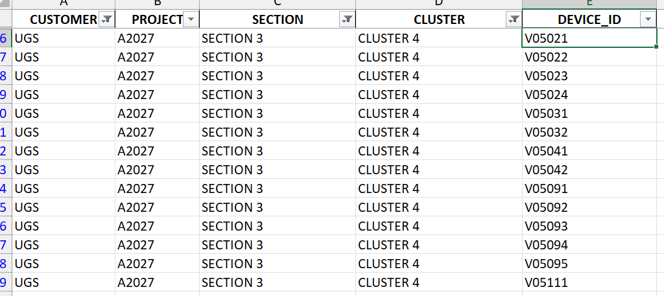
From training dataset.
All SECTION 3 CLUSTER 4 refer to “V”
All contain 1 similar devices
(refer to On/Off Valve)

Slide 61
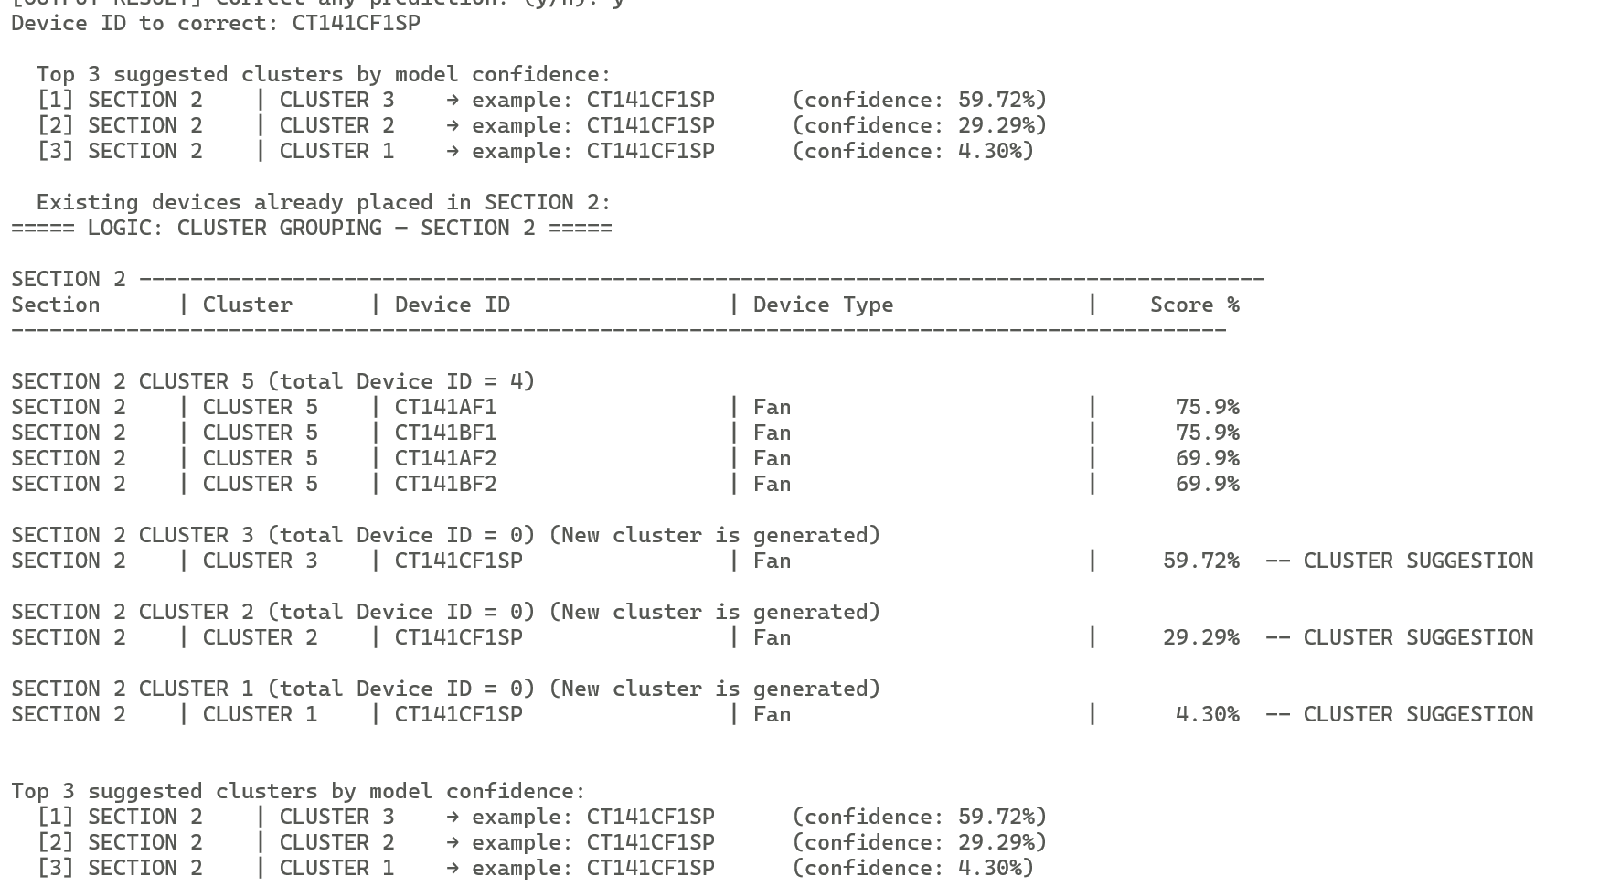
EXAMPLE 2 : CT141CF1SP

Slide 62
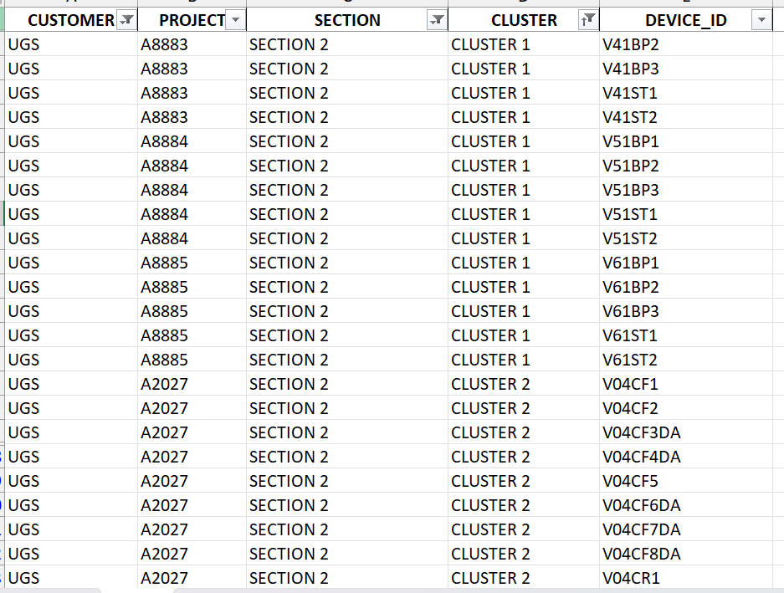
EXAMPLE 2 : CT141CF1SP

Slide 63
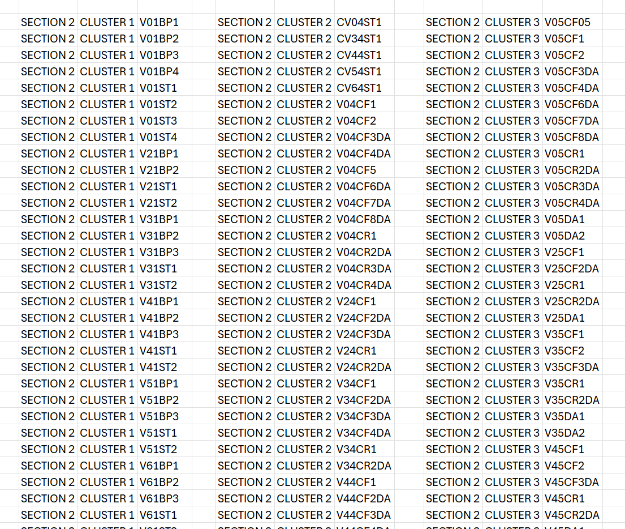
DISTRIBUTION OF THE DATASET
SECTION 2 CLUSTER 1
32 ITEM OF V
(On/off valve)
SECTION 2 CLUSTER 47 V (On/off valve)
SECTION 2 CLUSTER 2
5 CV (control valve)
41 V (On/off valve)

Slide 64
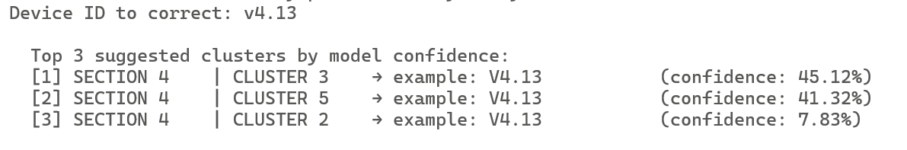
GENERATED ON 14/07/2026
V4.13 – SECTION4 CLUSTER?

Slide 65
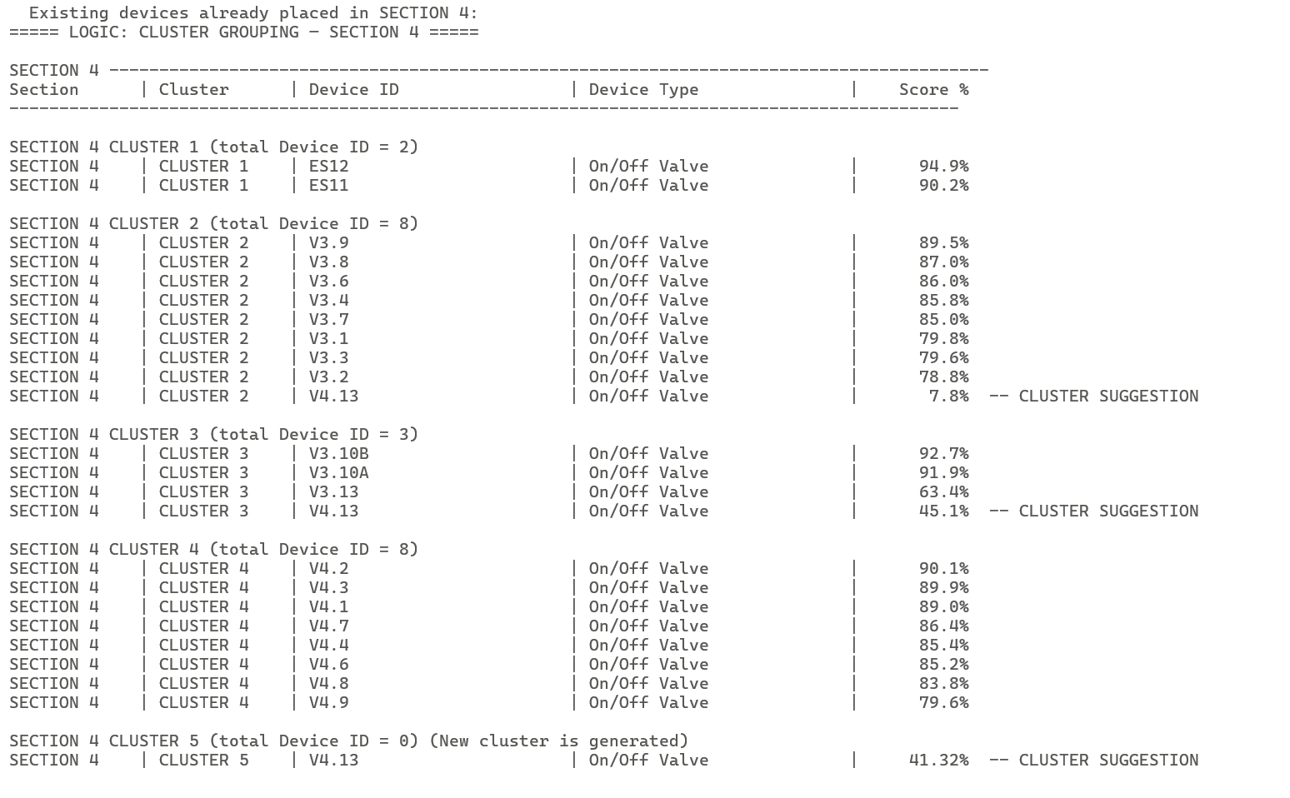
GENERATED ON 14/07/2026
V4.13 – SECTION4 CLUSTER?

Slide 66
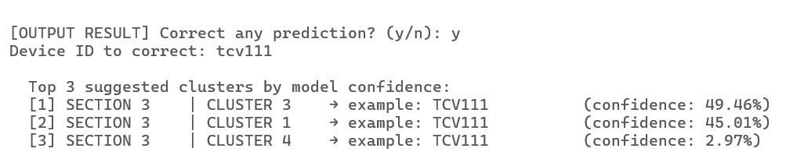
GENERATED ON 14/07/2026
TCV111 – SECTION 3 CLUSTER?

Slide 67
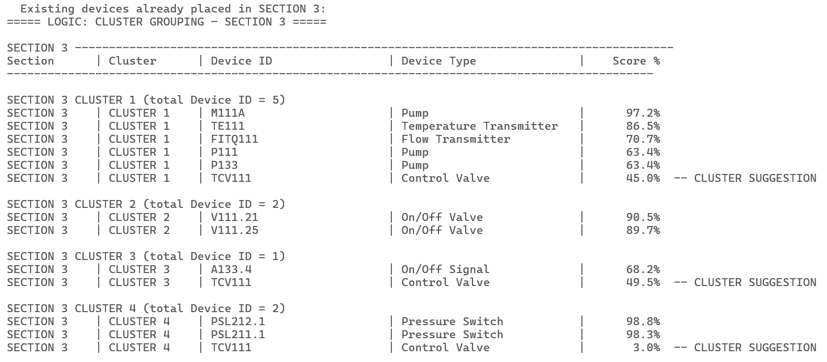
GENERATED ON 14/07/2026
TCV111 – SECTION 3 CLUSTER?

Slide 68
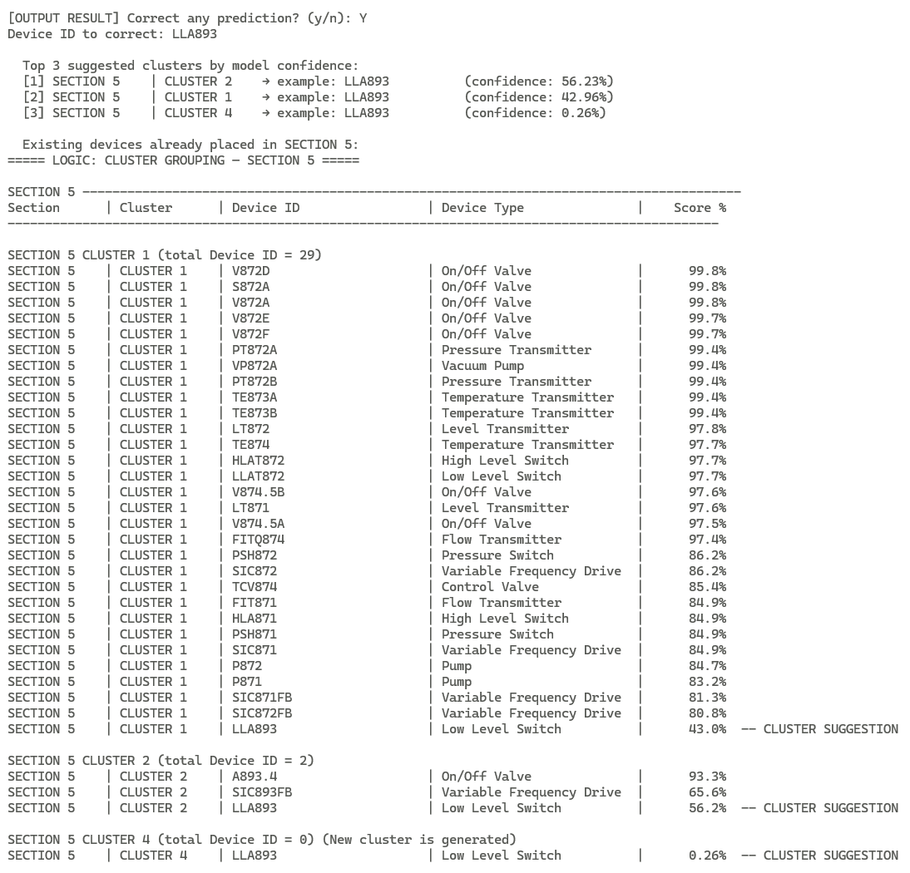
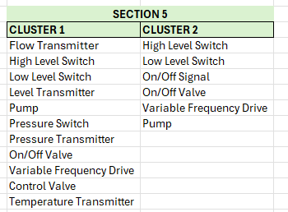
LLA893 – SECTION5
CLUSTER?

Slide 69
THE END
REFERENCE
[10/07/2026]

Slide 70
MACHINE LEARNING PIPELINE
INPUT
(Customer, Project, Device ID)
CREATE ON (18.03.2026)
UPDATE ON (20.0.2026)
NEW LIST EQUIPMENT
ML MODEL
UPDATE & SAVE MODEL
PREFIX
SUFFIX
SGD Classifier Hybrid Model
- SGD Classifier
- Composite Similarity
XGBoost
DBScan
Device Type
Section
Cluster
UNKNOWN
= Assign by User
RESULT OUTPUT
(Customer, Project, Device ID, Device Type, Section)
UPDATE & SAVE MODEL

Slide 71
MACHINE LEARNING PIPELINE
INPUT
(Customer, Project, Device ID)
UPDATE ON (16.04.2026)
1
ML MODEL
RETRIVE
[new_equipment.pkl]
SGD Classifier
XGBoost
NEW LIST OF EQUIPMENT
3
Data type
Cluster
Section
UNKNOWN
= Assign by User
RESULT OUTPUT
(Customer, Project, Device ID, Section, Cluster)
2
Process flow
(1) Input - Model – Result Output – Update & Save Model
(2) Input - Model - Output (UNKNOWN) - Assign by user – New Equipment Data
- Model – Update & Save Model
(3) New Equipment Data - Model - Update & Save Model
UPDATE & SAVE MODEL

Slide 72
MACHINE LEARNING PIPELINE
UPDATE ON (15.06.2026)
INPUT from DB
(Customer, Project, Device ID)
1
ML MODEL
RETRIVE
[new_equipment.pkl]
SGD Classifier
XGBoost
NEW LIST OF EQUIPMENT
3
Data type
Cluster
Section
UNKNOWN
= Assign by User
RESULT OUTPUT
(Customer, Project, Device ID, Section, Cluster)
2
UPDATE & SAVE MODEL

Slide 73
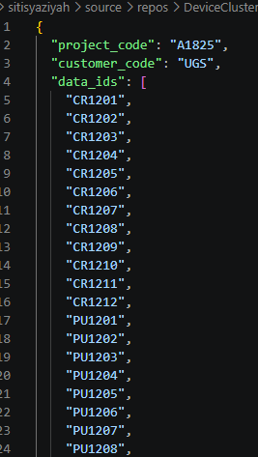
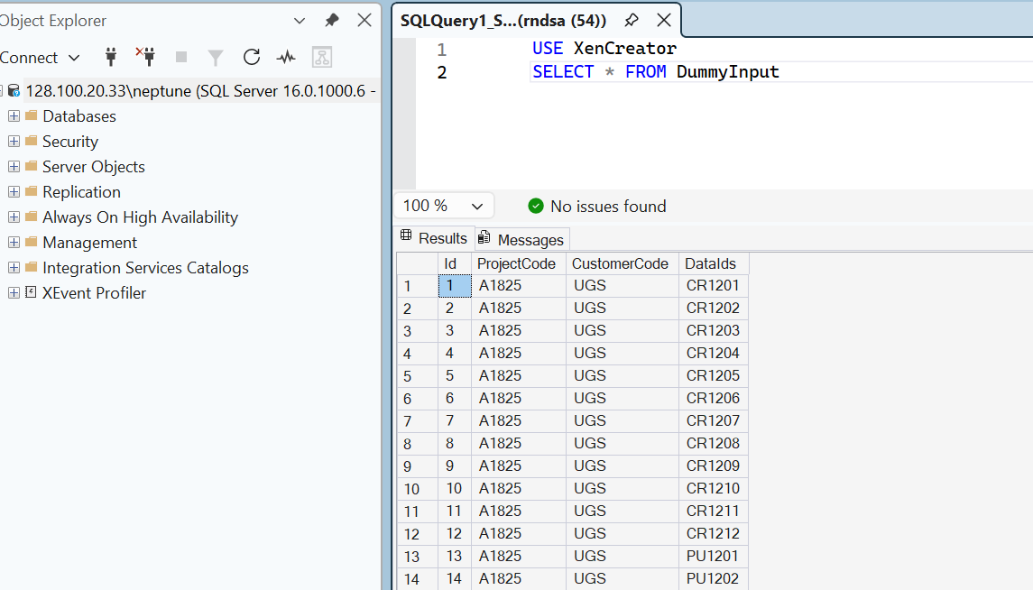
SQL : From DB to Json

Slide 74
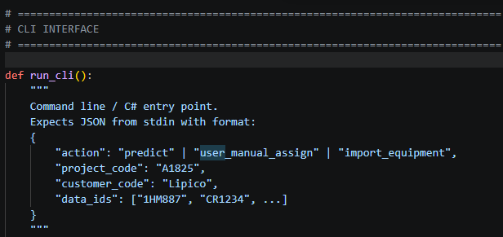

Slide 75
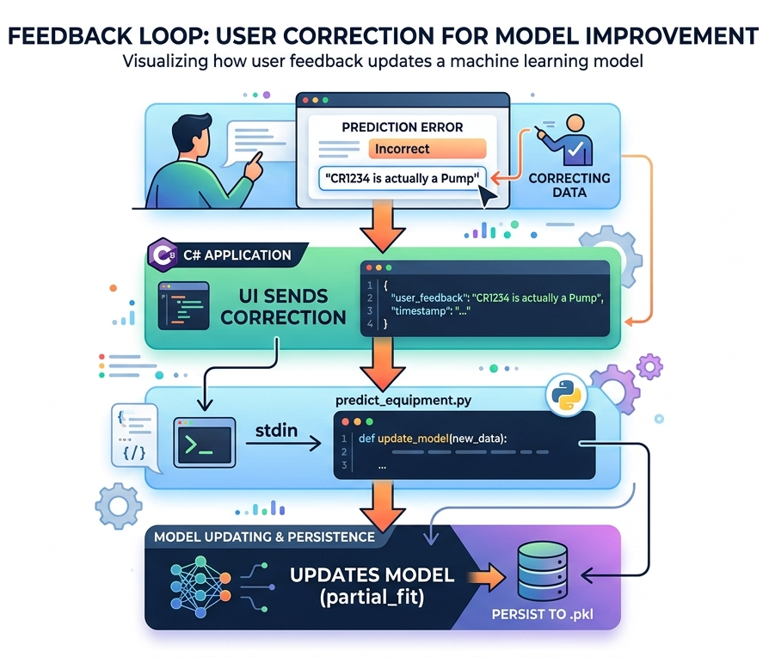
manual assign
type, section, cluster
workflow

Slide 76
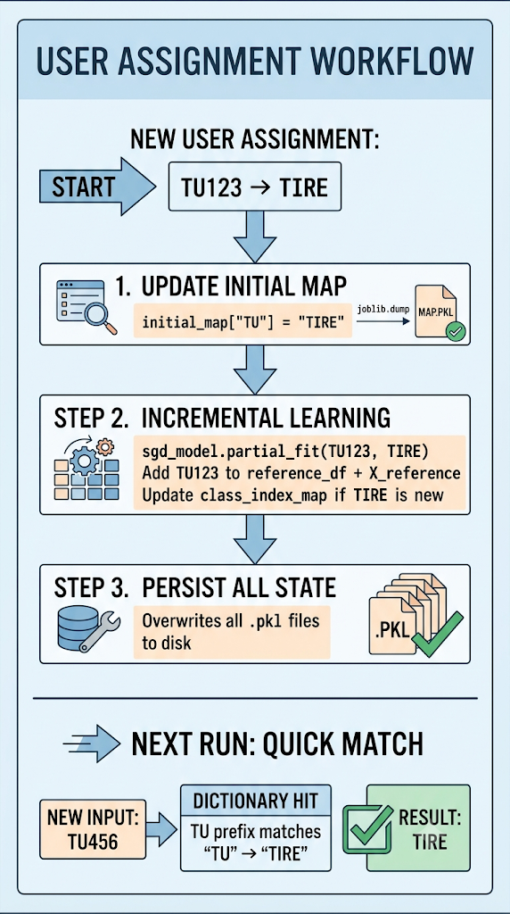
manual assign
type, section, cluster
workflow

Slide 77
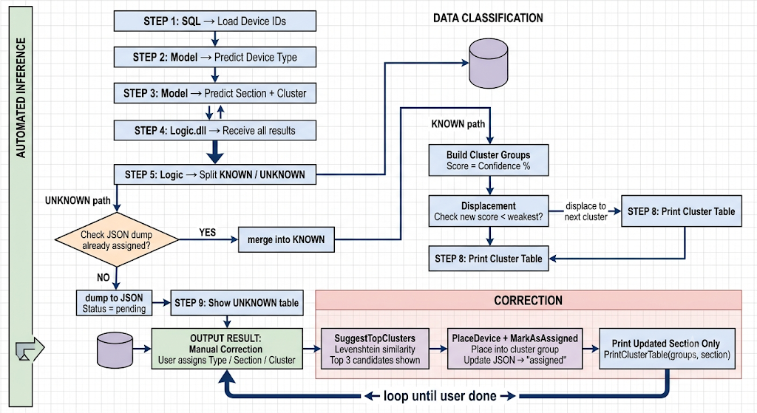

Slide 78
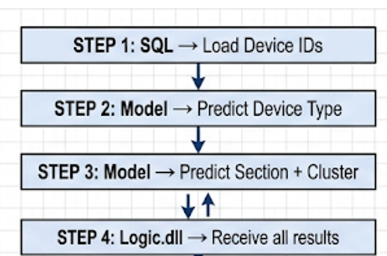
UNKNOWN
Pending Table (JSON dump)
KNOWN
CLUSTERED GROUP (Table)
User Assign
yes
no
Suggestion similarity
(section, cluster)
Type – auto save
Remain in JSON dump
User Assign

Slide 79
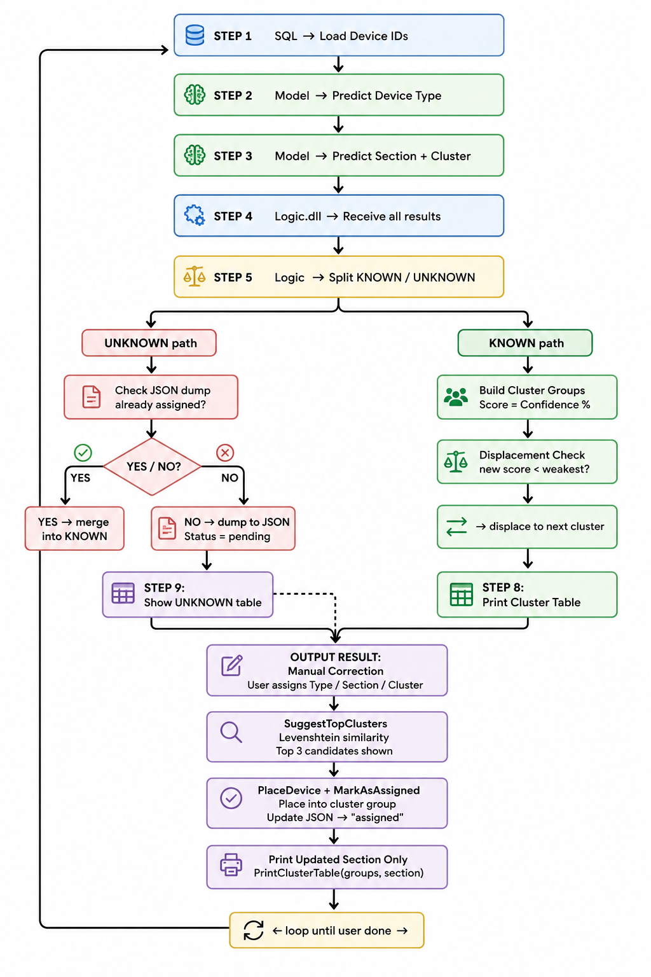

Slide 80
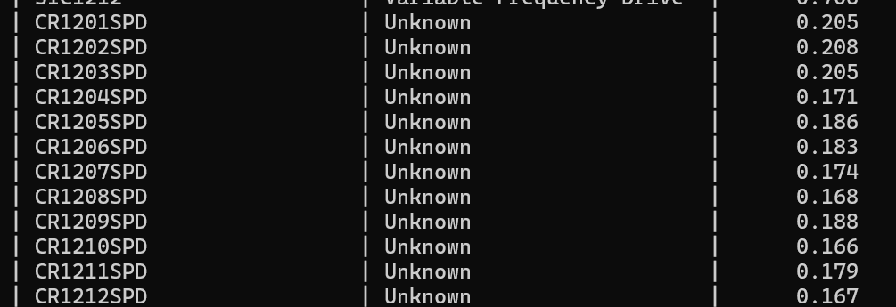
Source Project A1825 - LIPICO : CR___SPD refer to Control Valve/VSD.
But for CR refer to agitator. Hence the model unable to captured what is the right device type for this

Slide 81
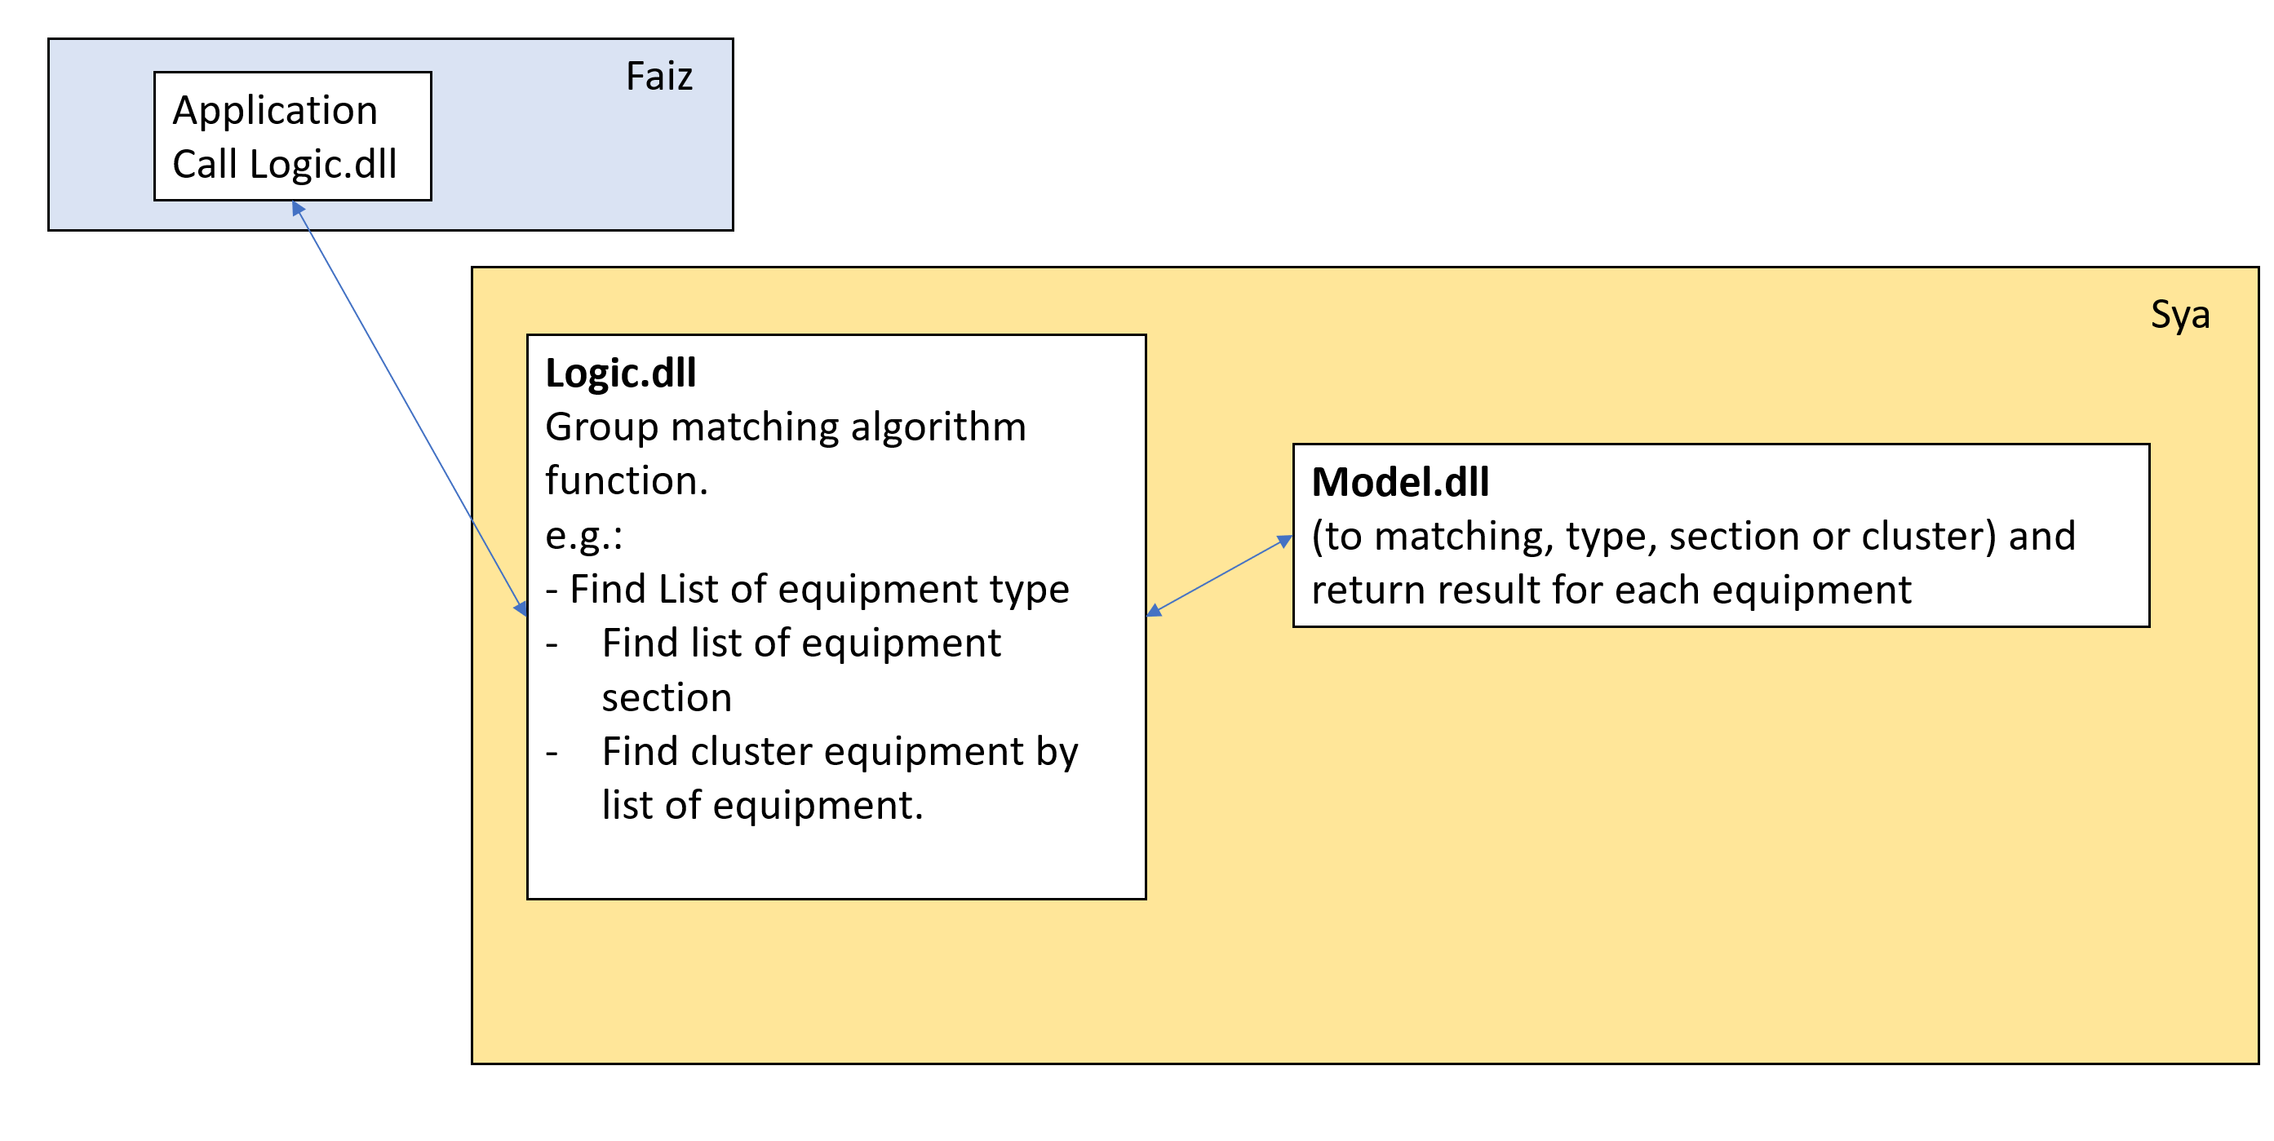

Slide 82
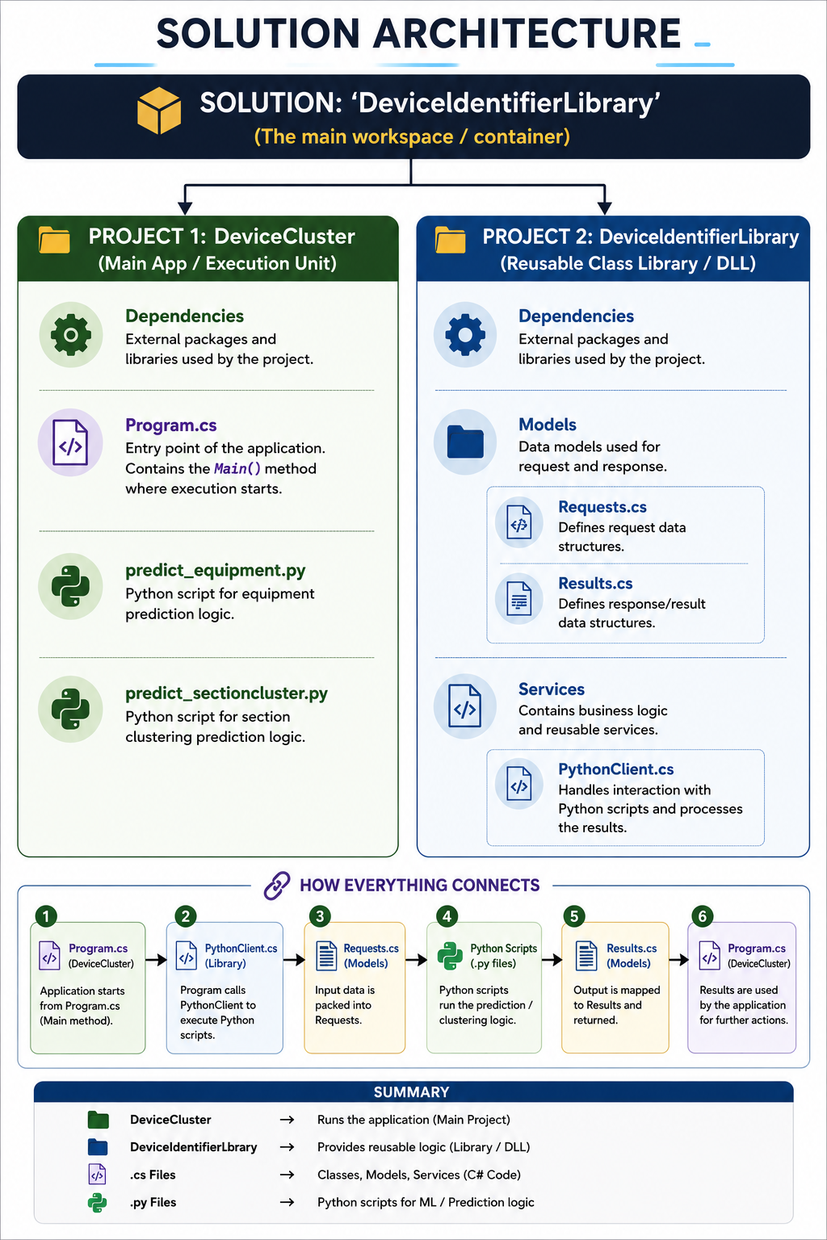
DeviceIdentifierLibrary
workflow

Slide 83
Training model
(N = 1132)
Remove duplication = 1123
Training = 786
Validating =168
Testing = 169
reference_df
(N = 1321)
master_df
(N = 1321)
Model Application
(N = 385)
Known = 250
UNKNOWN= 135
UNKNOWN
(N = 135)
DeviceType = 23
DeviceSection = 6
DeviceCluster = 106 [PREDICTION % BY THE MODEL]
= suggest % the top 3
Action = remove the LV distance and similarity

Slide 84
DeviceCluster -
Logic.dll
AppRegistryEditor
DeviceCluster
[PROJECT CONSOLE]
Test all the function to makesure it works
Show the UI in console apps

Slide 85
DeviceCluster
[PROJECT CONSOLE]
Load SQL
Predict Type
Predict Section
Predict Cluster
Logic – Cluster Grouping
Logic – UNKNOWN
Assign Device Type
Assign Device Section
Assign Device Section
Save
Save
Suggestion top 3 from model
Restructure and Kick

